Slide 1
INFO - 3170 - LAB3
Prof. Dr. Duraid M. Nouri
Team group names:
Aline Crispe Barbieri da Costa
Anu Saroya
Jade George
Meet Patel

Slide 2
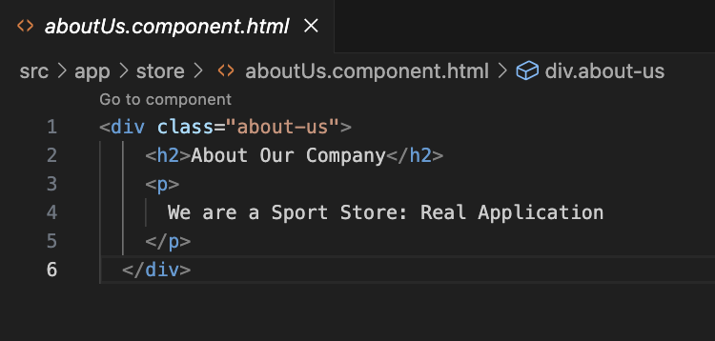
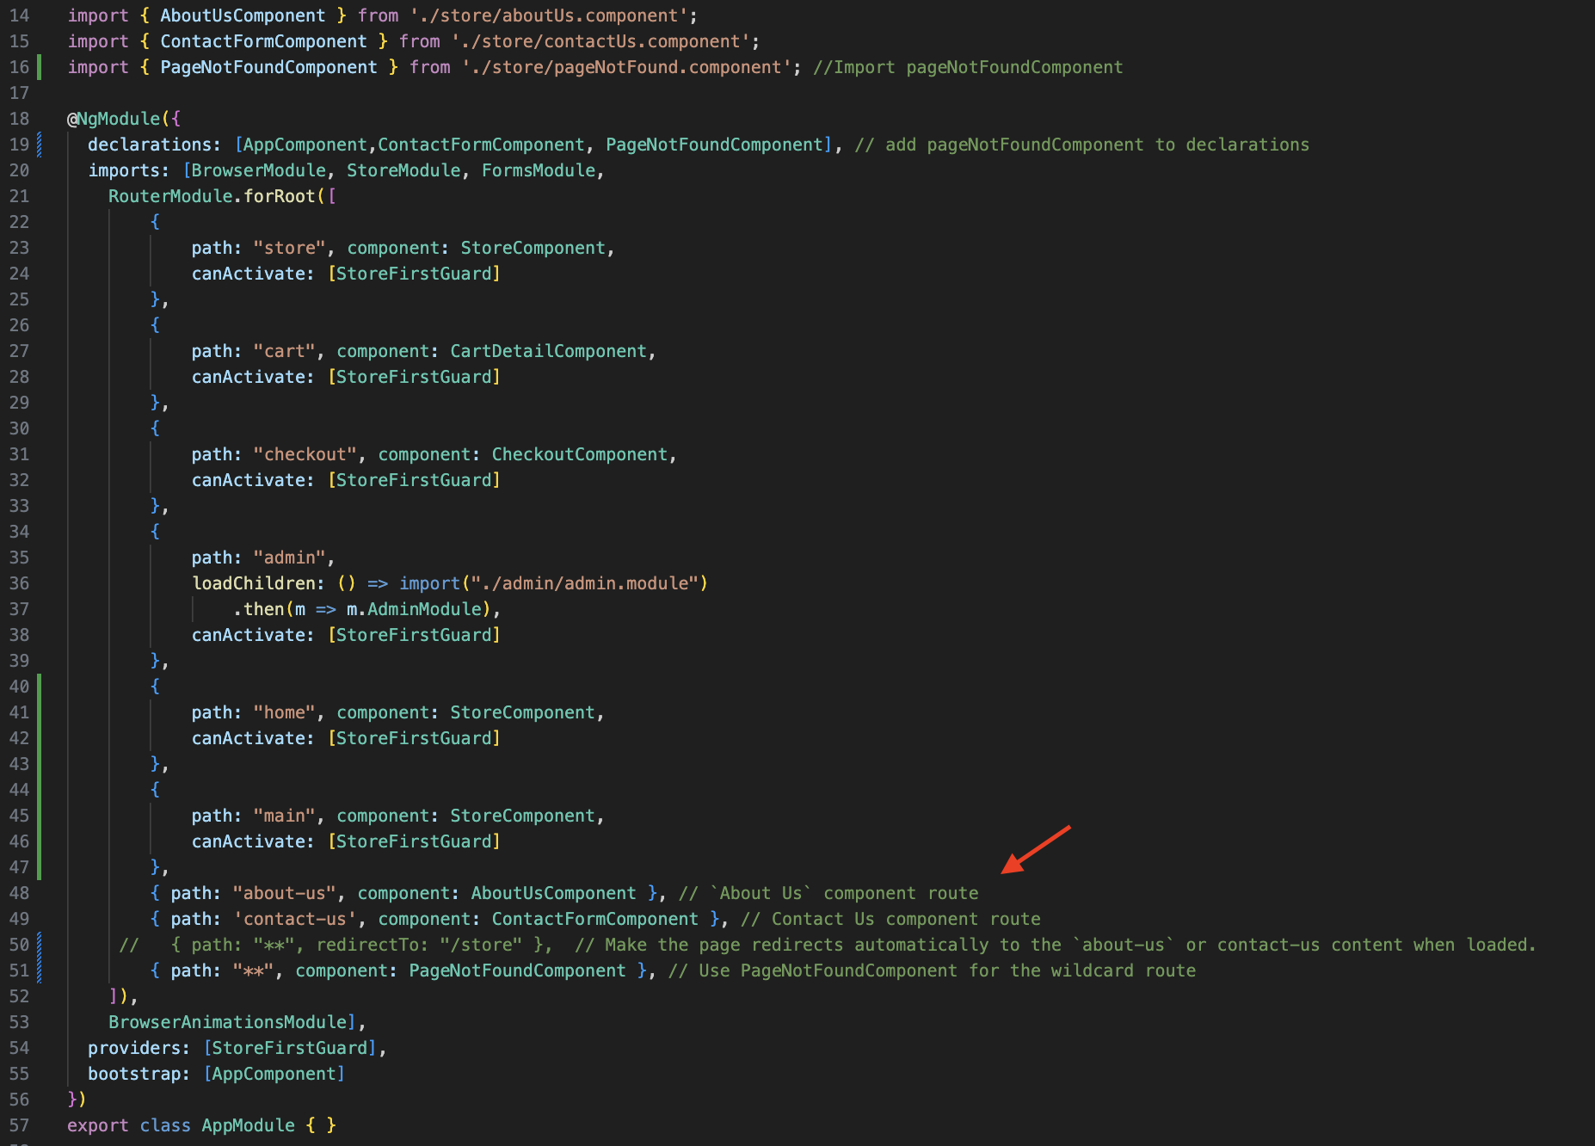
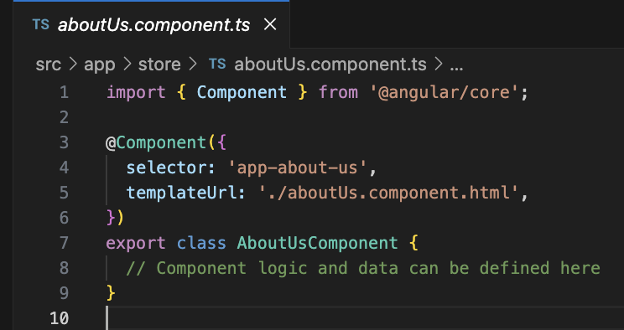
Include another route and component that will render an `About Us` component, with a page to provide information about the store. (2 points)
Make the page redirects automatically to the `about-us` content when loaded.(2 points)

Slide 3
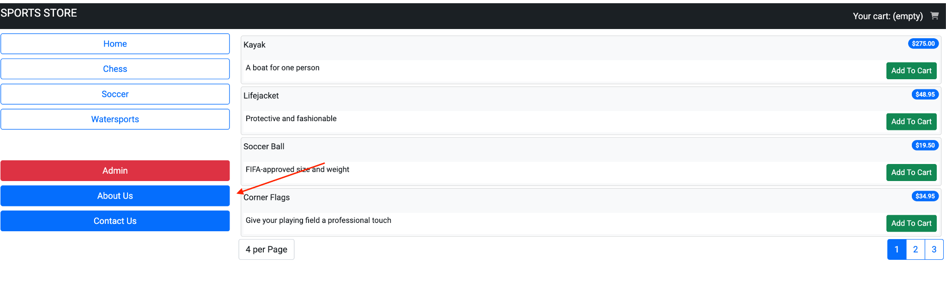
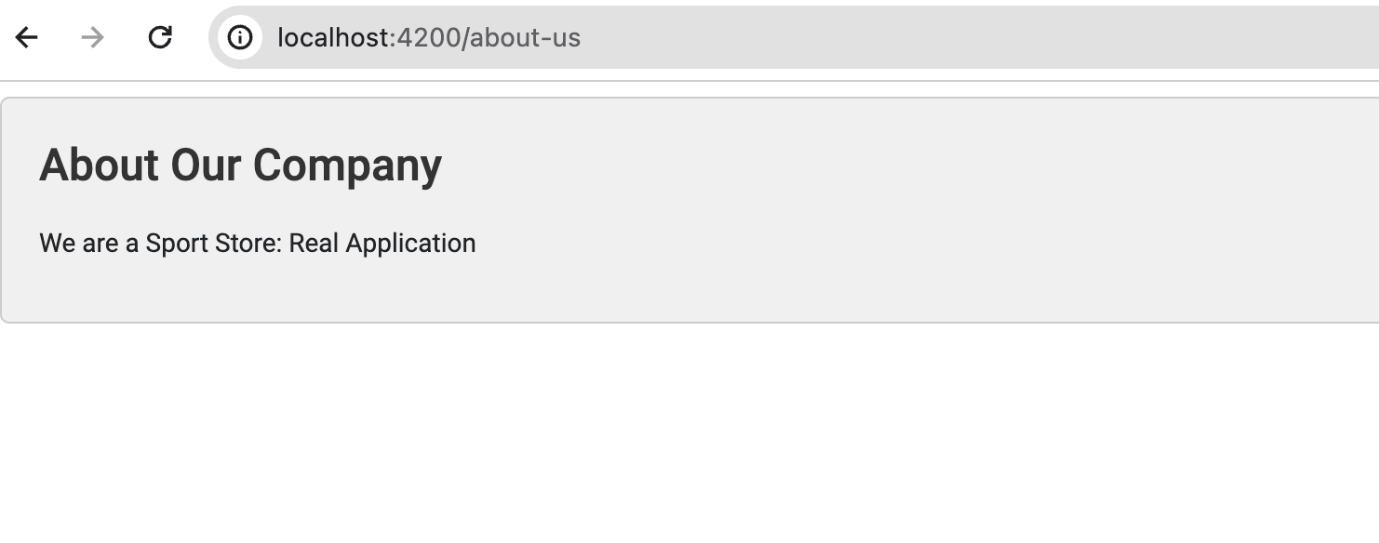
About-us Component

Slide 4
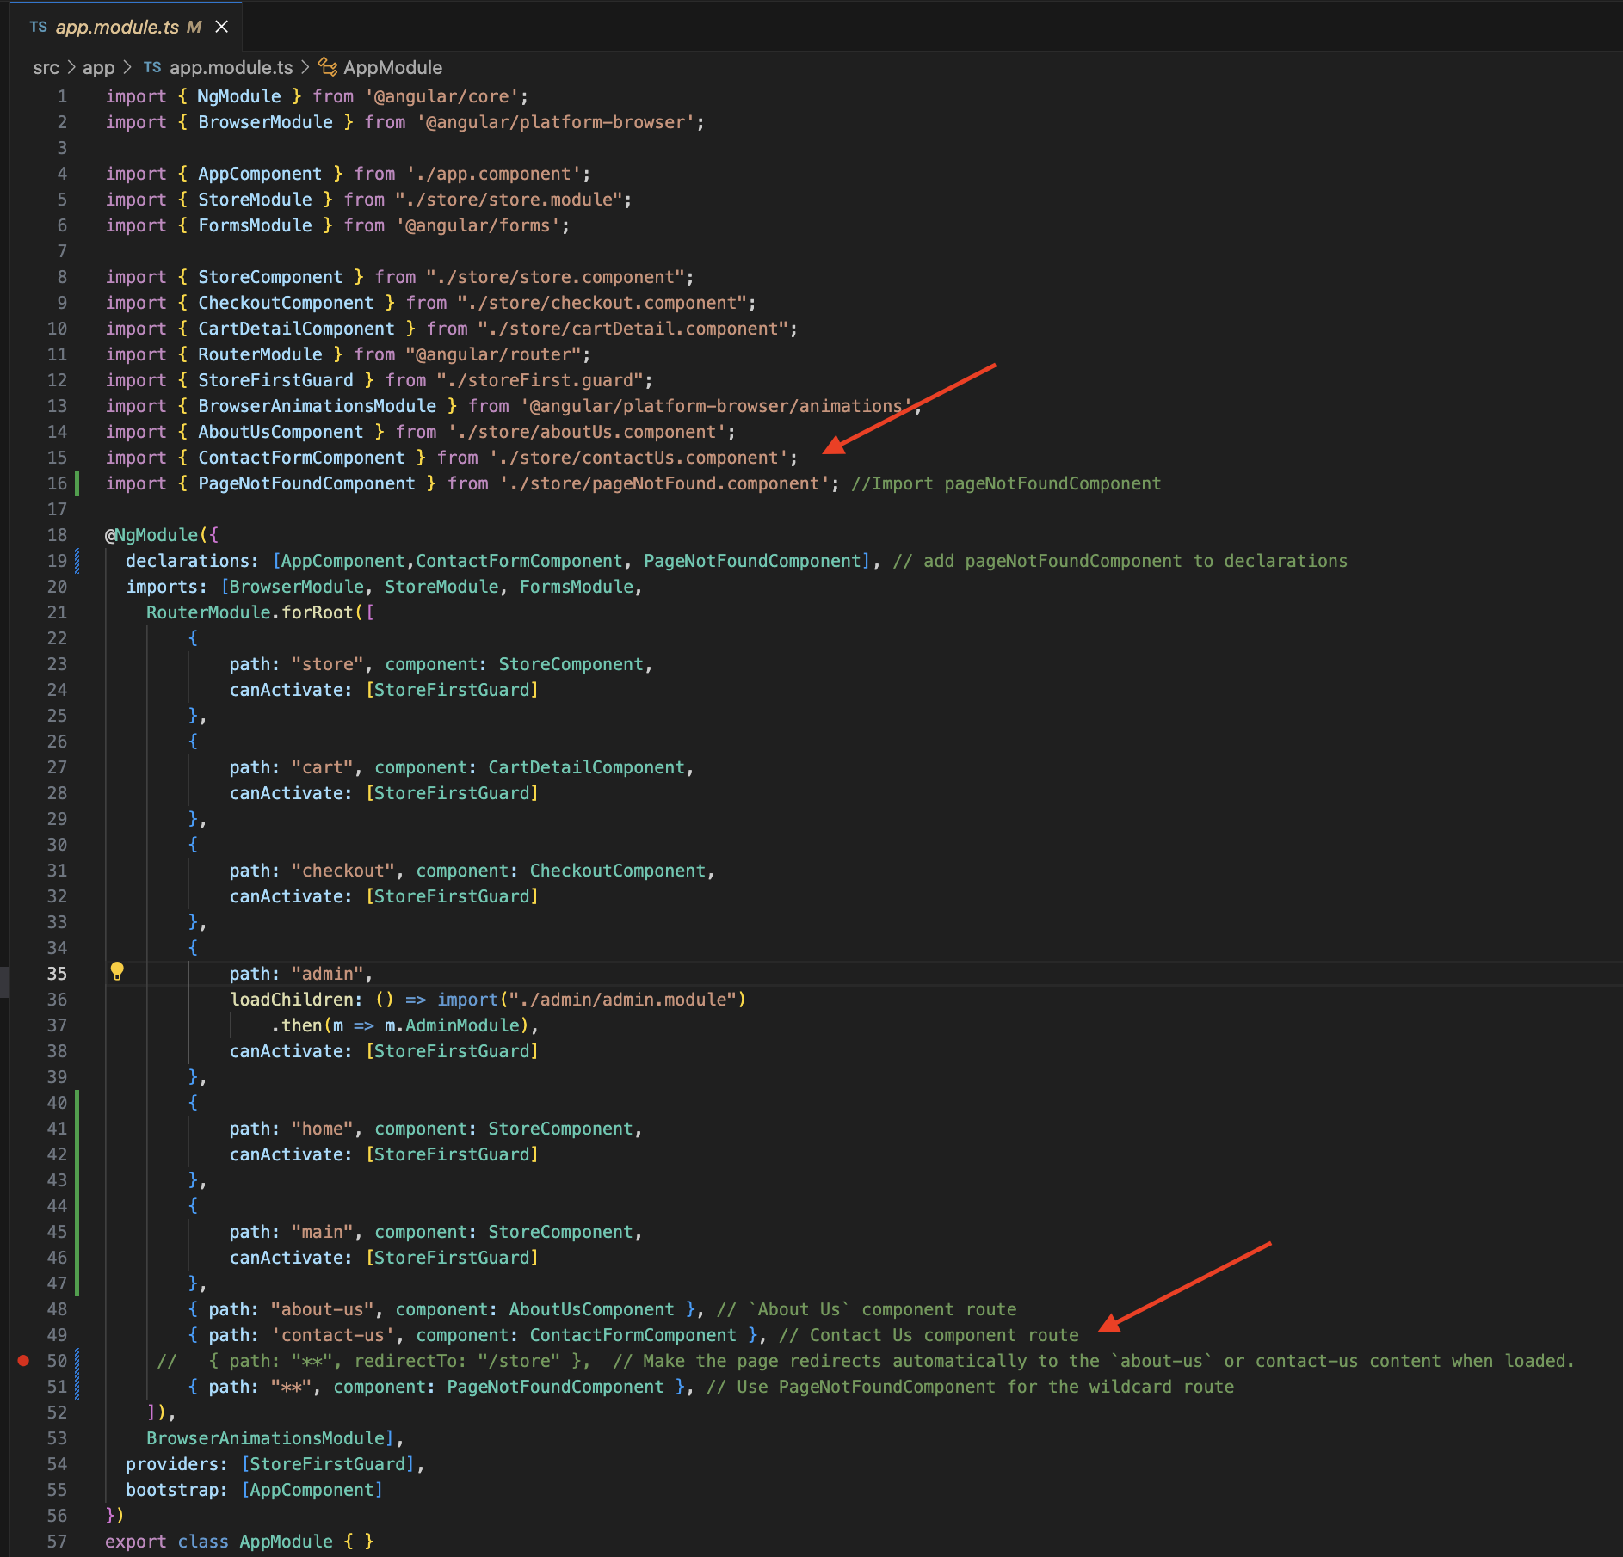
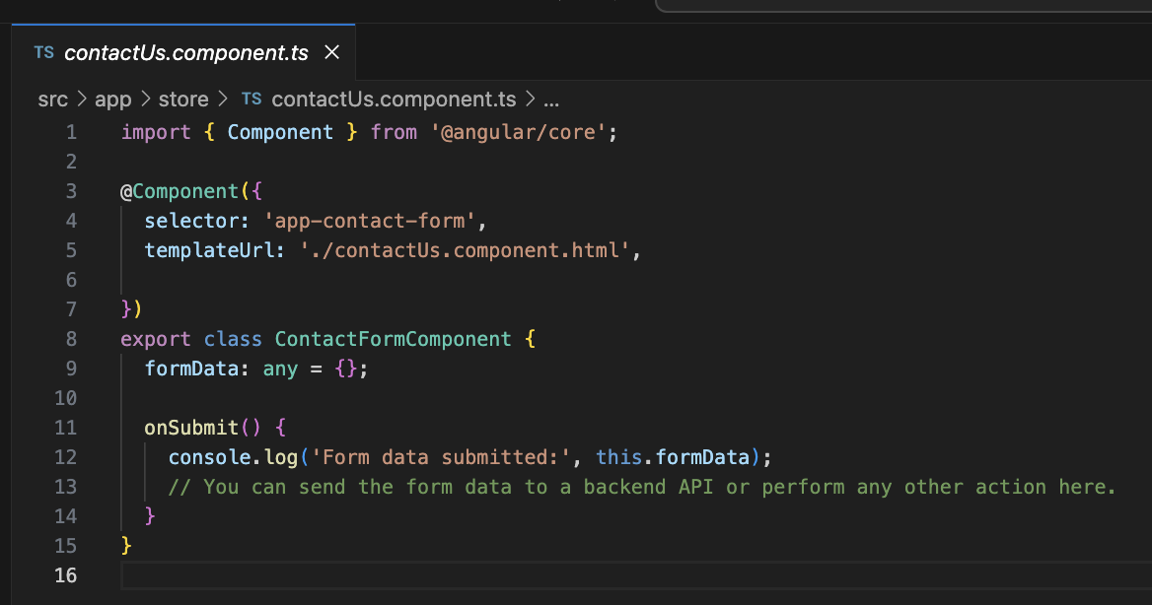
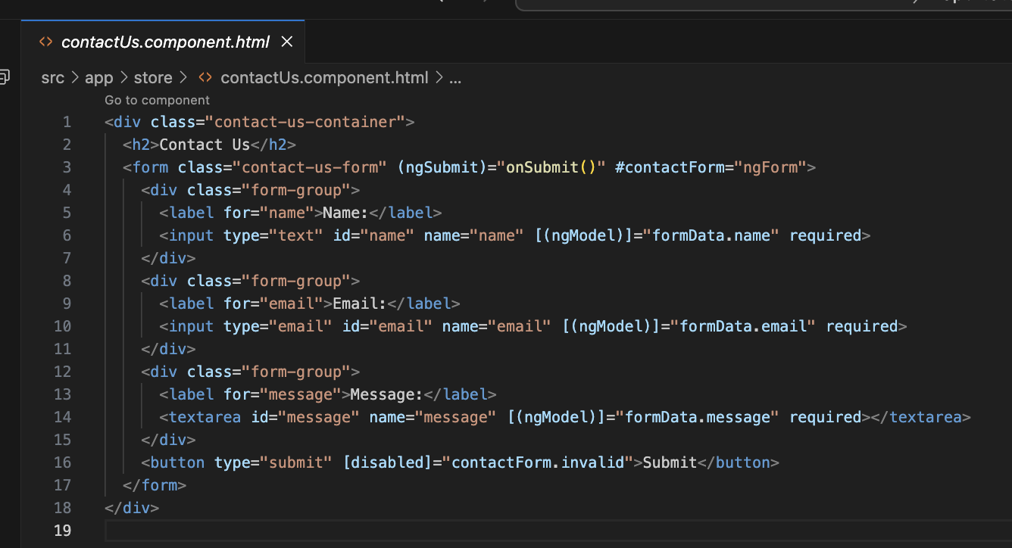
Create a fourth route with its respective component to be rendered. Choose what this new content is about. (2 points)
Make the page redirects automatically to this new content when loaded. (2 points)

Slide 5
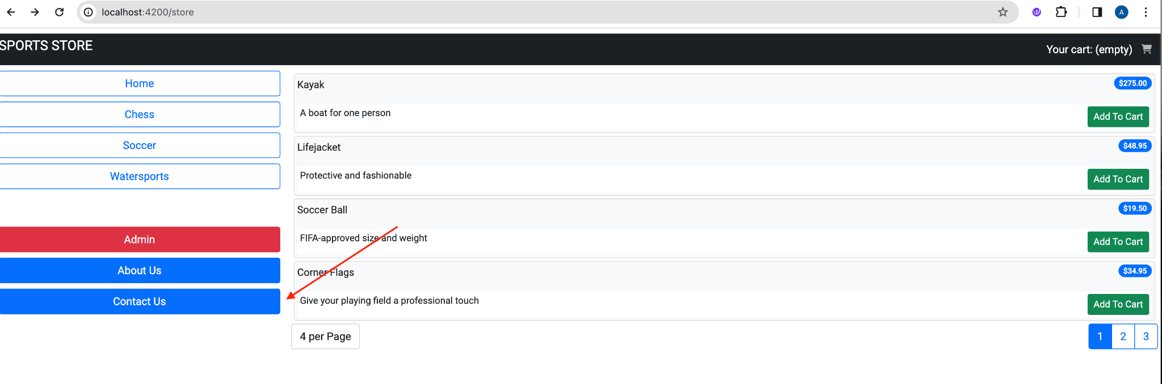
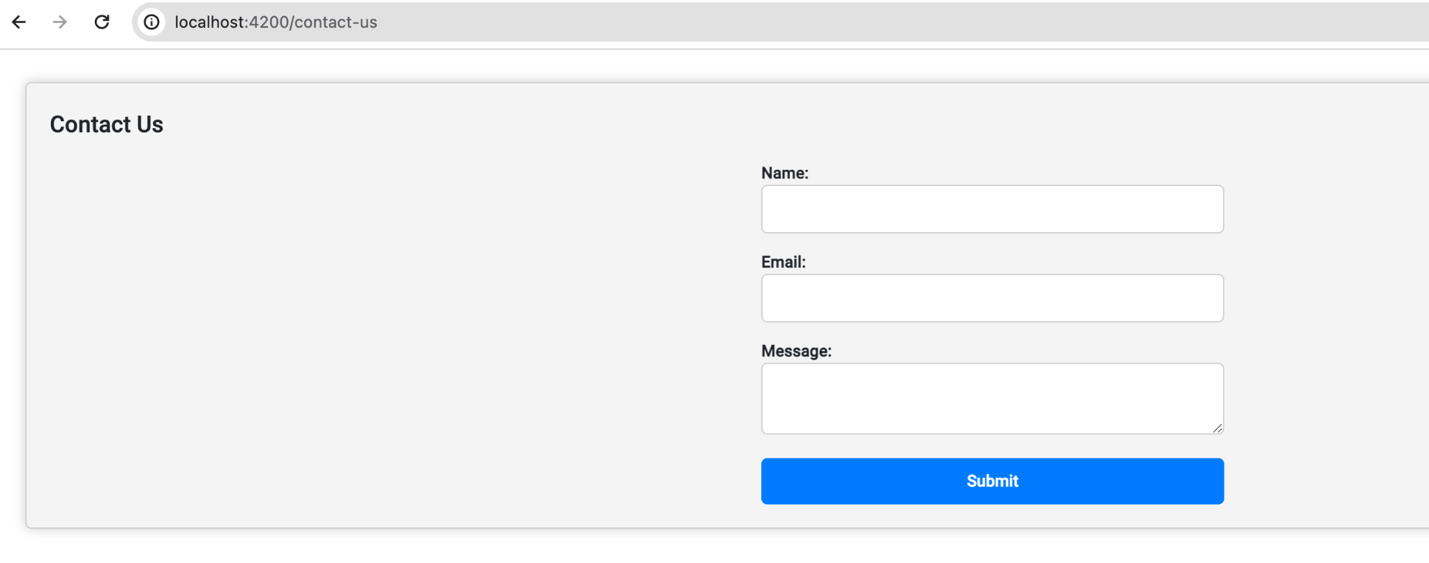

Slide 6
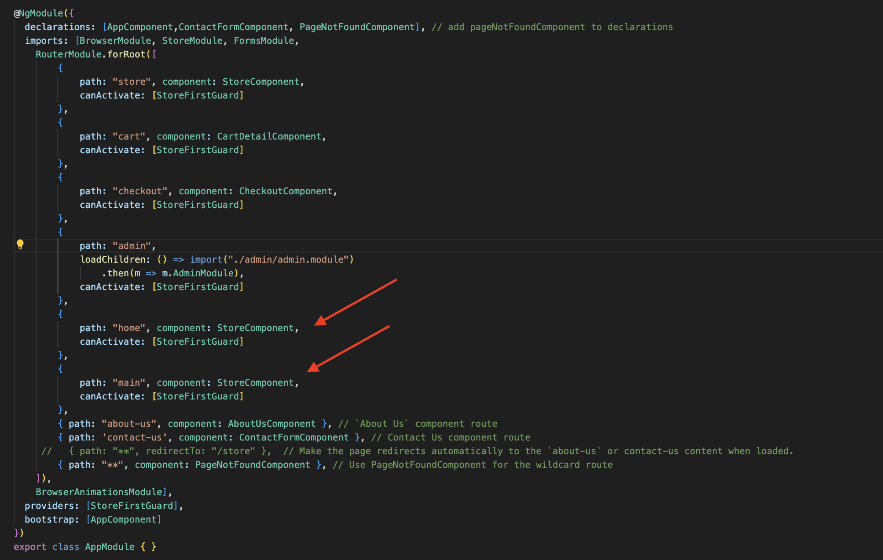
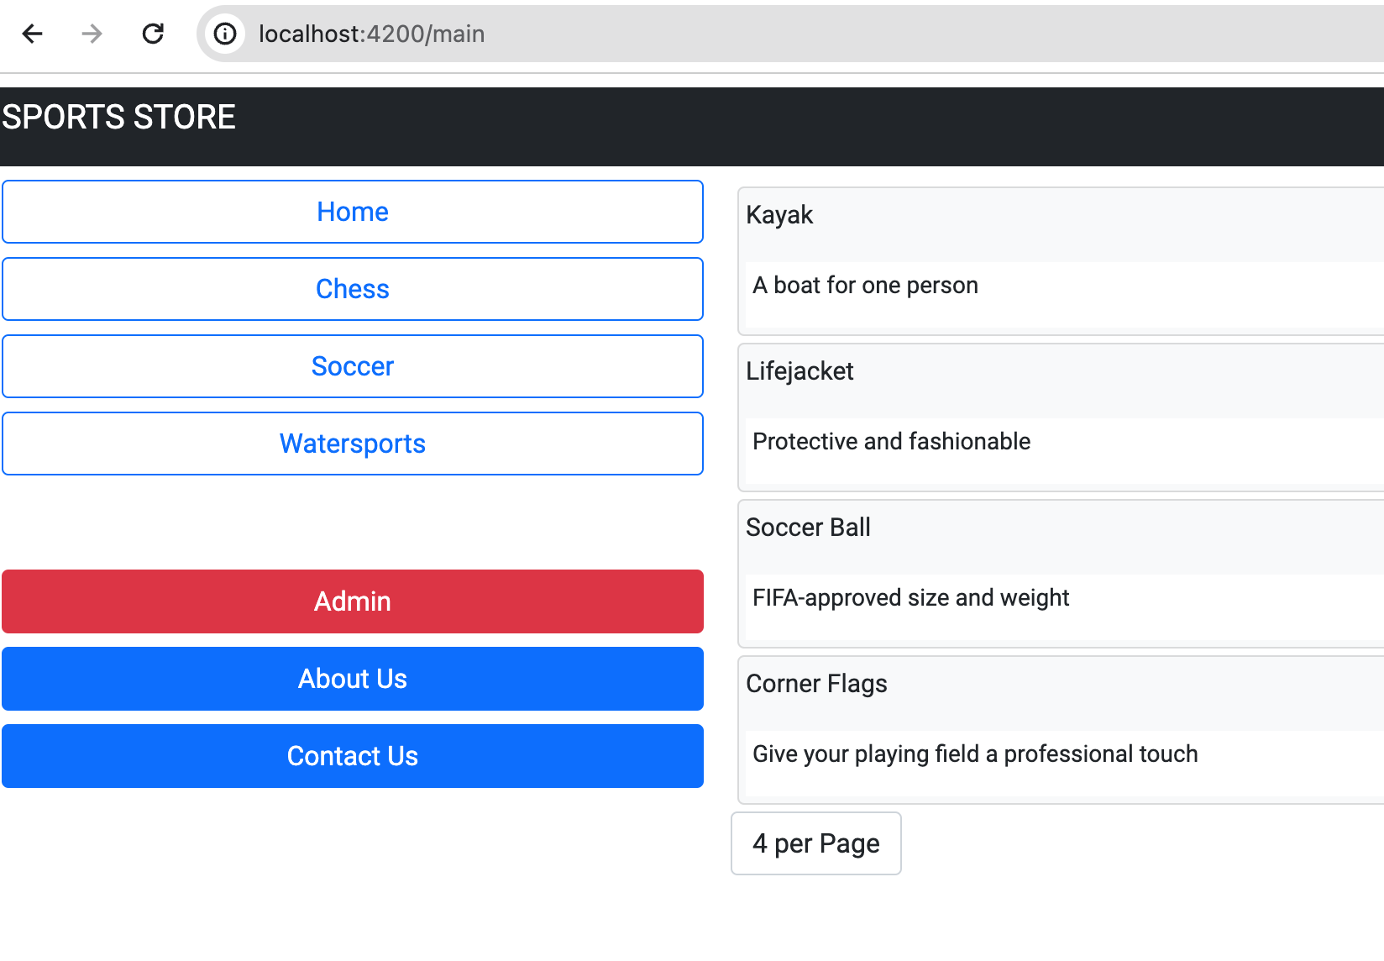
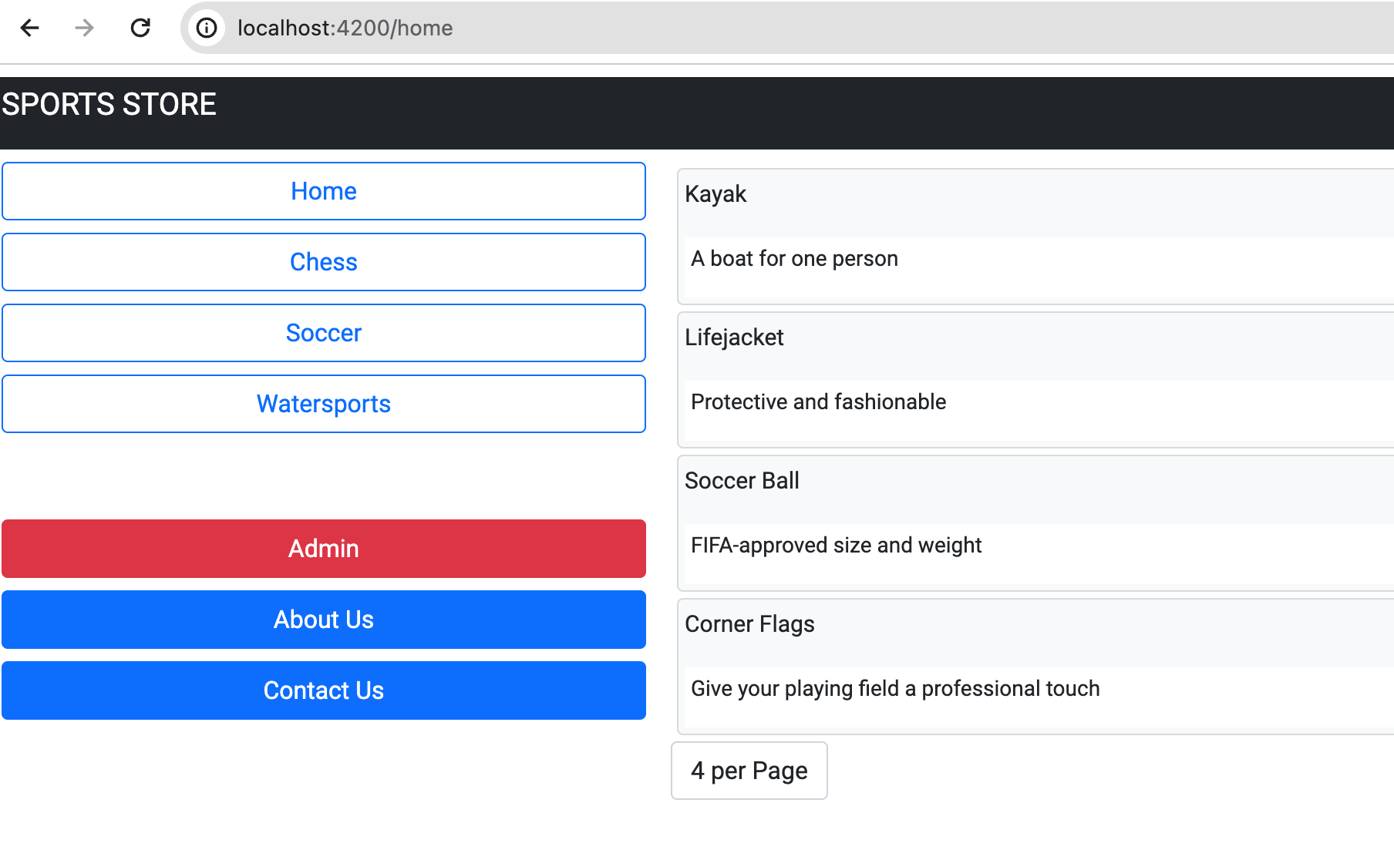
Create 2 more alternate routes to reach the products list page. (2 points)
Created - home and main route

Slide 7
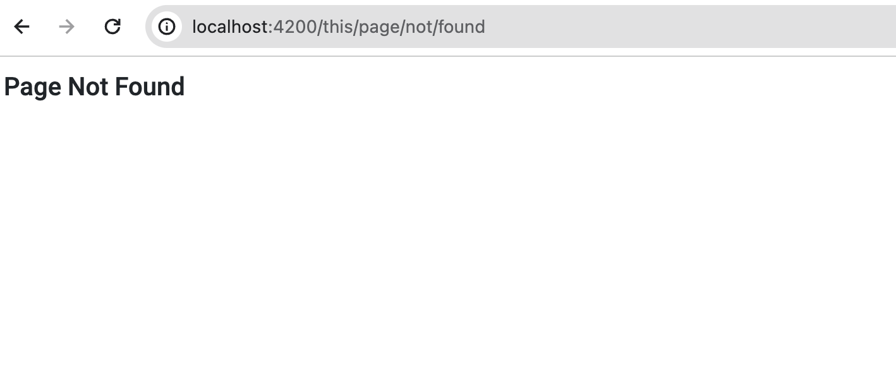
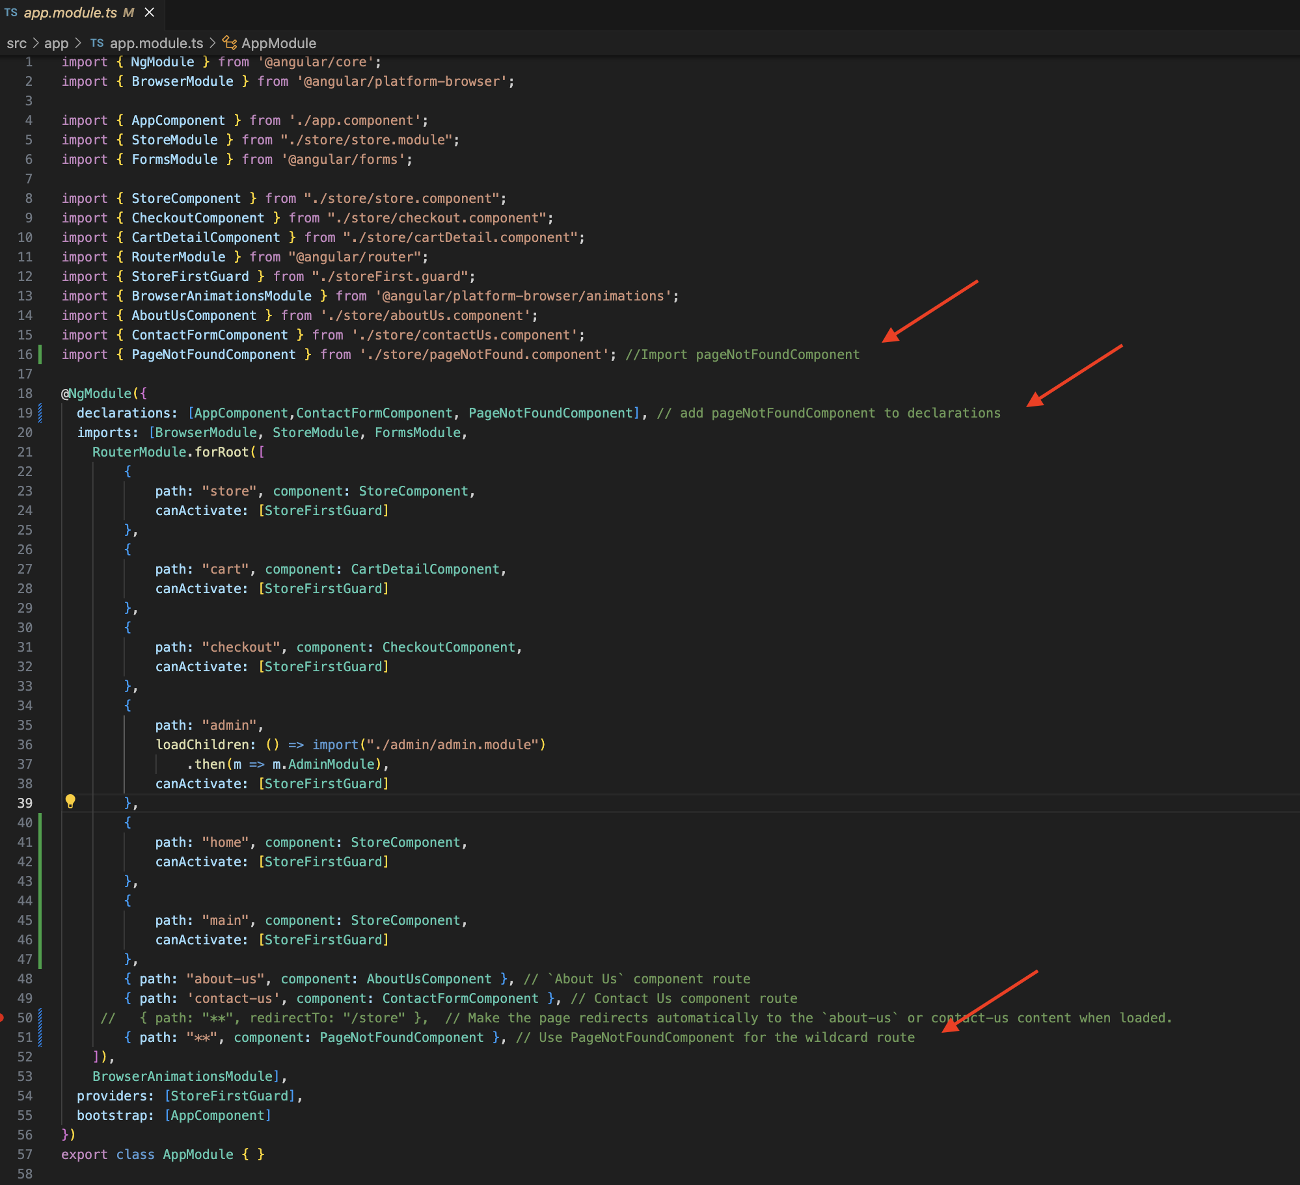
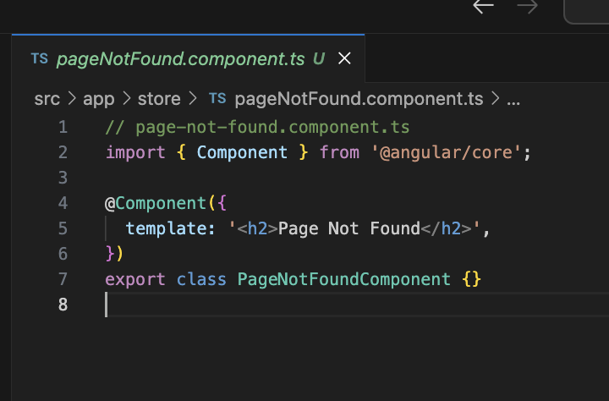
Challenge: Refactor the code so that the Page Not Found can be rendered WITHOUT the navigation buttons and the page title. (Bonus: 3 points)

